Slide 2
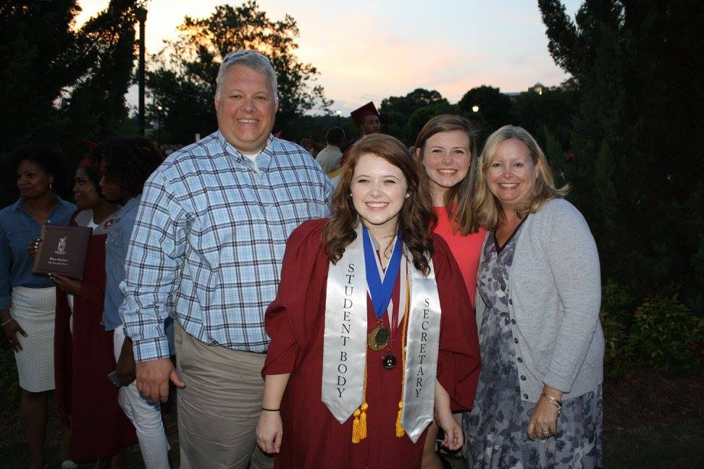
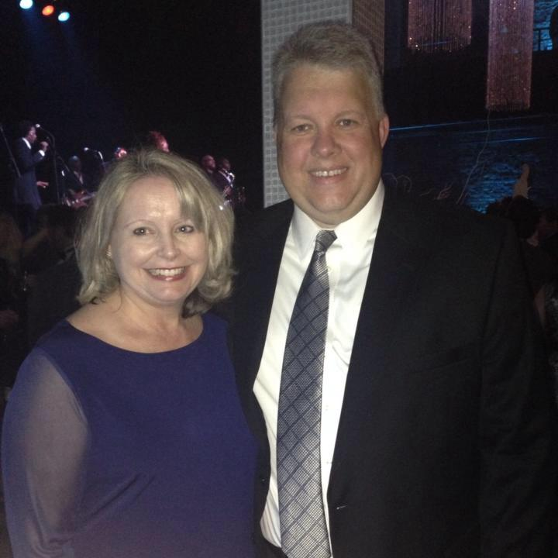
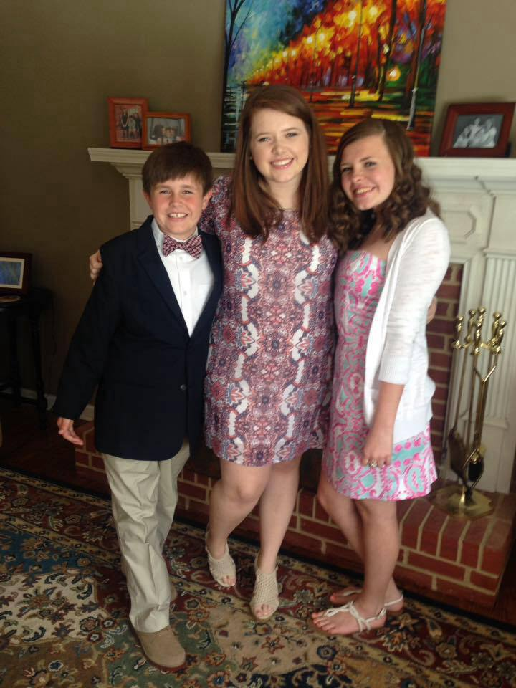
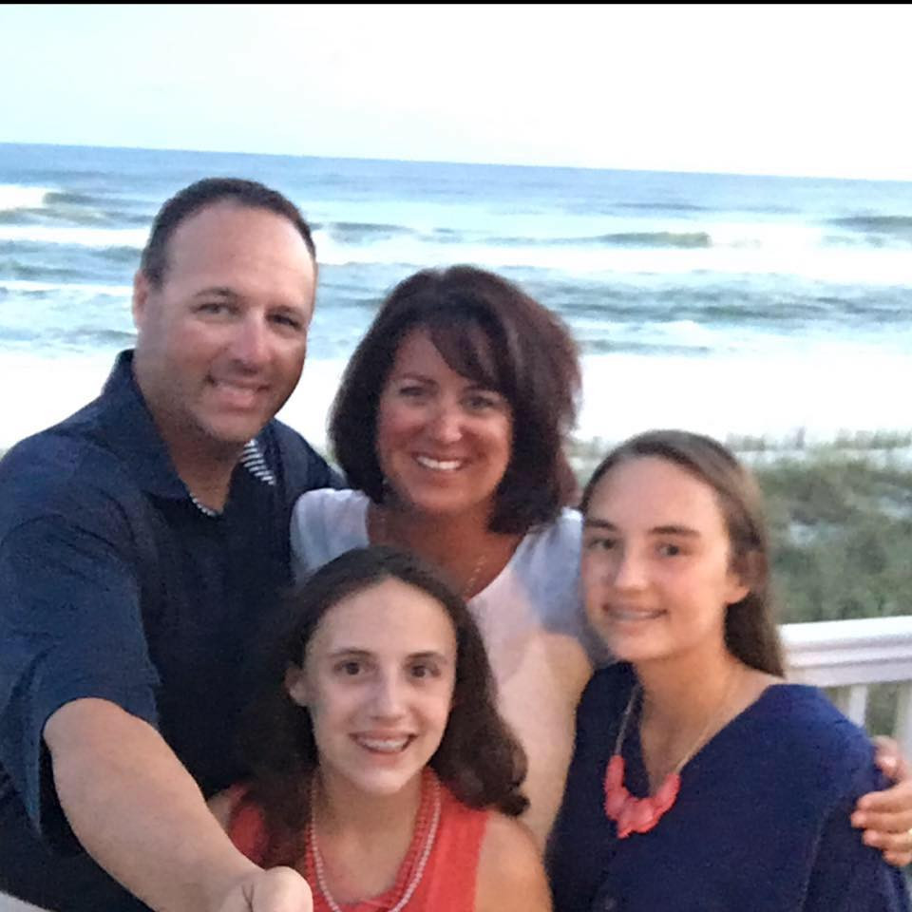
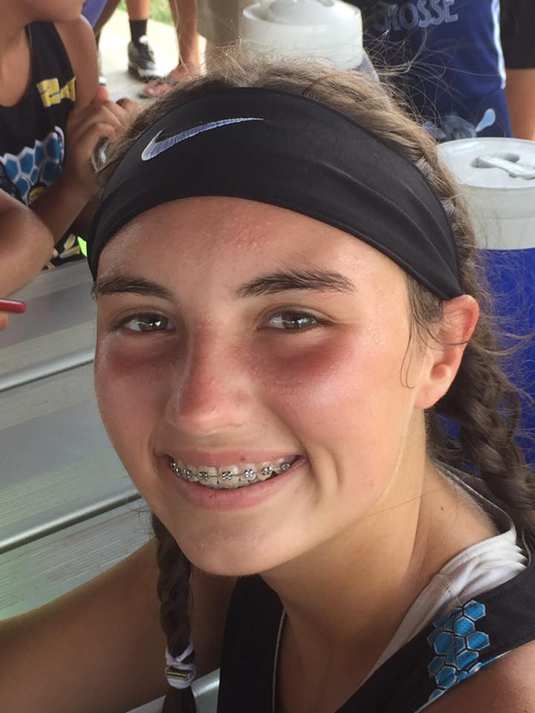
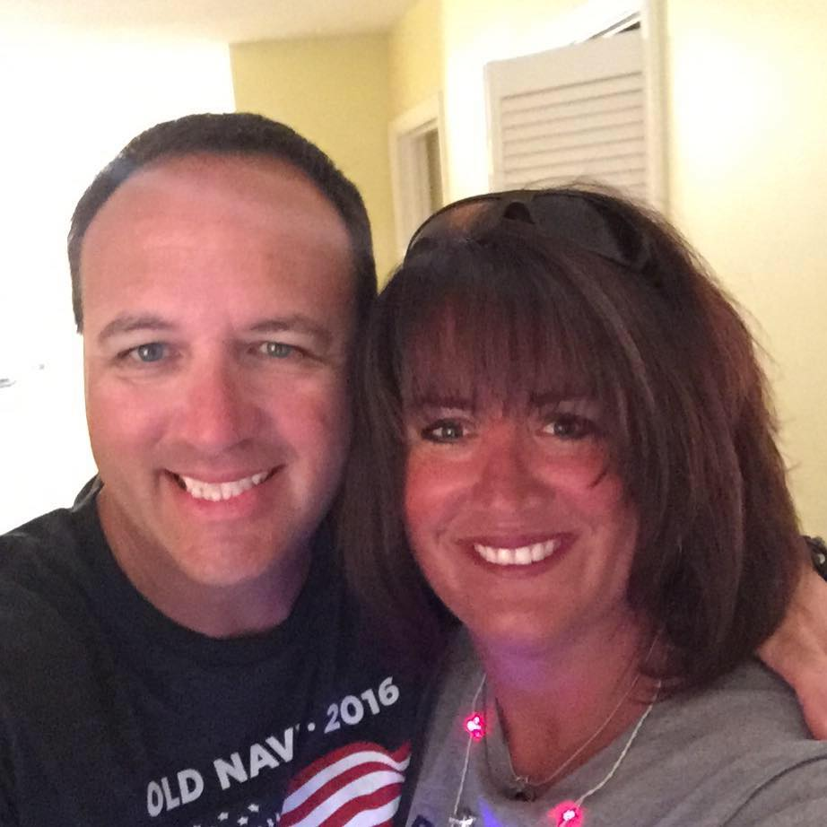
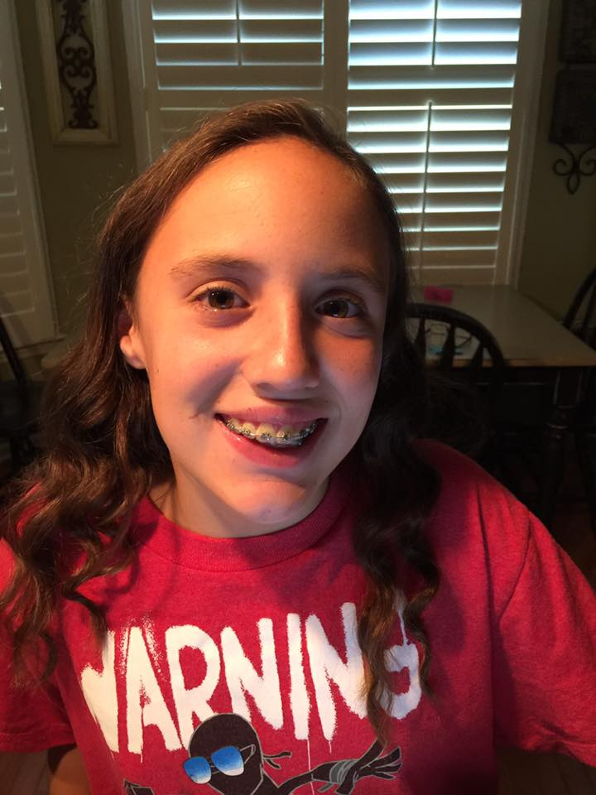
Meet Mrs. Crimm &
Mrs. Hyde
Meet
Mrs. Crimm & Mrs. Hyde

Slide 3
Curriculum Points
Reading: Good Habits/Great Readers (Shared Reading and Guided Reading)
Phonics: Build It Up/ Benchmark Literacy
Mathematics: Harcourt Brace (whole group instruction and guided math groups)
Social Studies, Science, and Health: integrated through language arts
Zaner Bloser Handwriting
Sight Words: 200 most frequently seen print words in reading text
*We are teaching a lot of the curriculum through the use of our Interactive Smart Boards.

Slide 4
The Daily 5
Our class is implementing a new literacy structure that teaches independence.
Students have a choice of books and centers that interest them and pick daily.
5 Centers (Read to Self, Work on Writing, Read to Someone, Listen to Reading, Word Work)
Students Role: Choose Three Centers Daily
Teachers Role: Guided Reading Groups, One on One
Mini-Lessons: Phonics, Reading Strategies

Slide 5
How will I be updated about my child’s progress?
Quarterly standards
based report
cards
Requirements in
meeting standards
changes each
quarter
Graded work is sent
home with a 1, 2, 3,
or 3+
*see parent brochure
4 ½ week Academic
Alert/Progress
Report
will be sent
home to notify you
of weaknesses

Slide 6
Homework
Homework will begin September 12th.
All written assignments will be
placed in your child’s Blue Daily
Communication Folder each Monday and
should be returned no sooner than Friday.
Sight words should be practiced
throughout the week.
Read 15 minutes nightly and record on
reading log.
Addition/subtraction facts (0-12) should be
practiced throughout the week.

Slide 7
more info…
Please encourage your child to use legible
handwriting on homework and phonetically
sound out words when spelling.
Make-up work for absences will be placed
in your child’s cubby.
Work is not given ahead of time for
unexcused absences.

Slide 8
Good “BEE”havior
See closet door entitled, Good “BEE”havior”
Classroom Rules are posted on front wall.
“Bee-ing Super”: Exceptional behavior (Caught doing something that makes the student a role model.) This is an instant reward trip to the Treasure Box.
“Bee-ing Great”: Great behavior and Great work habits (throughout the day) Students earn a “Caught You Being Good” Coin.
“Bee-ing GOOD” (Green): Good behavior and Good work habits (throughout the day) Student start the day here. The goal is to stay or move up from here because this is meeting the desired expectation.
“Bee Ware”: Verbal teacher warning given to remind the student to make better choices with behavior and/or work habits.
“BEE careful” : Consequences decided by teacher. Students automatically will lose 5-10 minutes of recess time.
“PARENT CONTACT” : Teacher contacts parent by note and/or phone call. Students automatically lose 10 minutes of recess time.
Students can earn Good Behavior Coins for Good Behavior. 5 coins equals a trip to the Treasure Box. “Being Super” is an automatic trip to the treasure box that day. “Being Great” is an easy way to get a daily Good Behavior Coin!

Slide 9
Star Student
Star Student Letter
Monday-poster
Tuesday-favorite stuffed animal
Wednesday-favorite book
Thursday-favorite game
Friday-show and tell object

Slide 10
Blue Daily Communication Folder
Make sure to check folder nightly for:
Bragging Behavior Sheet- sign daily
Reading Log
Weekly Newsletters and Monthly Calendar
Informational Papers/Flyers/
Graded papers
Notes from Mrs. Crimm/Hyde and/or to Mrs. Crimm/Hyde
Homework (sent home on Mondays and returned Fridays)

Slide 11
This and That…
A healthy snack should be sent daily.
Transportation changes must be in writing. NO EMAILS!
Visit our blog for information about our class. This can be accessed via the Ford website.

Slide 12
WE LOVE VOLUNTEERS!
Room Mom:
Mrs. Susan Meredith, Bailey’s mom
She will contact you about Classroom Helpers, Mystery Readers, etc.

Slide 13
Safety Concerns:
•Our building and classroom doors will be locked at all times.
•Upon arrival, ring the front doorbell and look into the camera. Please remove sunglasses and refrain from cell phone use at the camera. You may be questioned about the nature of your visit and asked to provide ID.
•Please do not hold the door open for other visitors and do not let other visitors in when you exit the building. Each visitor must ring the bell for entry into the building.
•Once you enter the building, report to the front office or please sign in at the computer in the front lobby. Please wear your visitor sticker at all times. Our staff has been trained to question any adult in the building not wearing a CCSD badge or visitor sticker.
•We request that no outside adults walk the halls of the building.
•The office can handle any needs you may have or deliveries to your child. They will direct you to the cafeteria if you are bringing a forgotten lunch to school.
•The Cobb County School District Police department will be conducting safety audits at all schools. We are fortunate to have a highly trained department providing support to all of the CCSD schools.

Slide 14
Safety Concerns Continued
Once you enter the building, report to the front office or please sign in at the computer in the front lobby. Please wear your visitor sticker at all times. Our staff has been trained to question any adult in the building not wearing a CCSD badge or visitor sticker.
•We request that no outside adults walk the halls of the building.
•The office can handle any needs you may have or deliveries to your child. They will direct you to the cafeteria if you are bringing a forgotten lunch to school.
•The Cobb County School District Police department will be conducting safety audits at all schools. We are fortunate to have a highly trained department providing support to all of the CCSD schools.

Slide 15
QUESTIONS?
THANK YOU FOR COMING TONIGHT. IT’S GOING TO BE A FANTASTIC YEAR!

